Slide 1
NAVIGATING MEE
JO KROUSSO 7.6.22
jokrousso@macmillaneducation.com

Slide 2
MEE DIGITAL FEATURES
Digital access – audio / navigation
Testing
Class management
Teachers’ resources

Slide 3
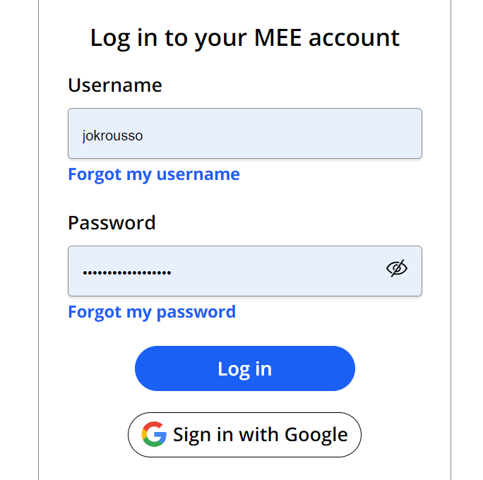
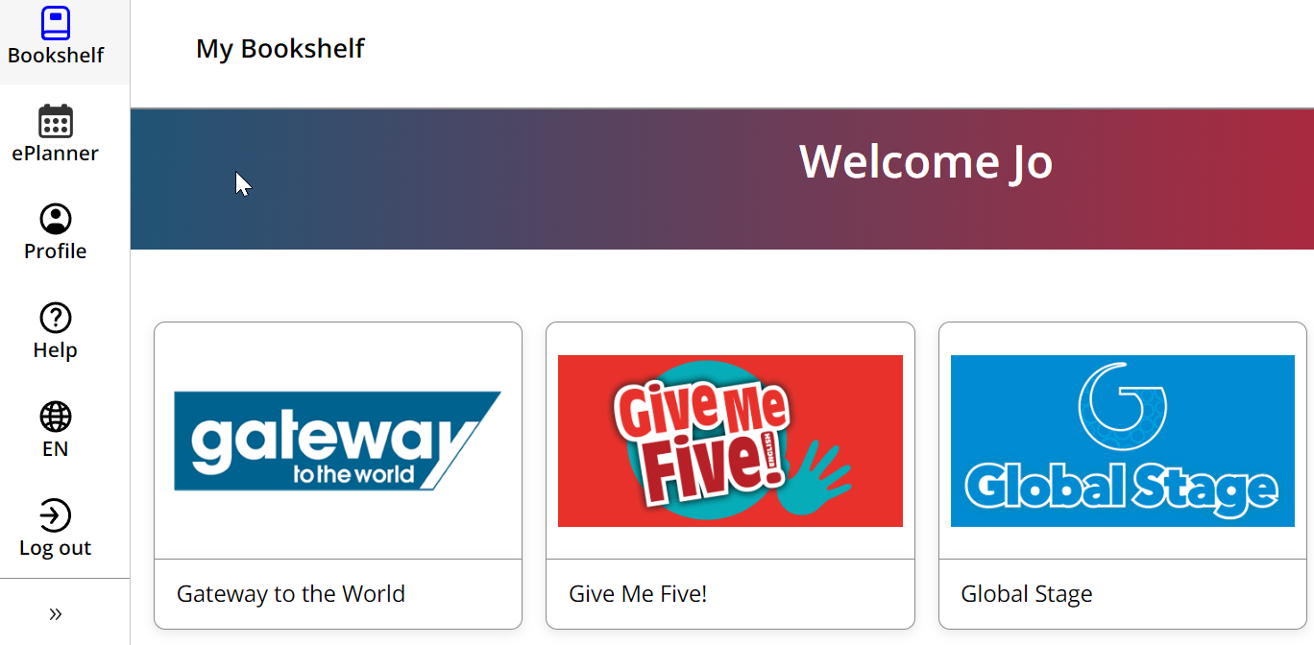
GETTING INTO IT – FIRST STEPS
Log in – DON’T USE GOOGLE!!!
Select series
Accessing the app / students book
Teachers’ resources

Slide 4
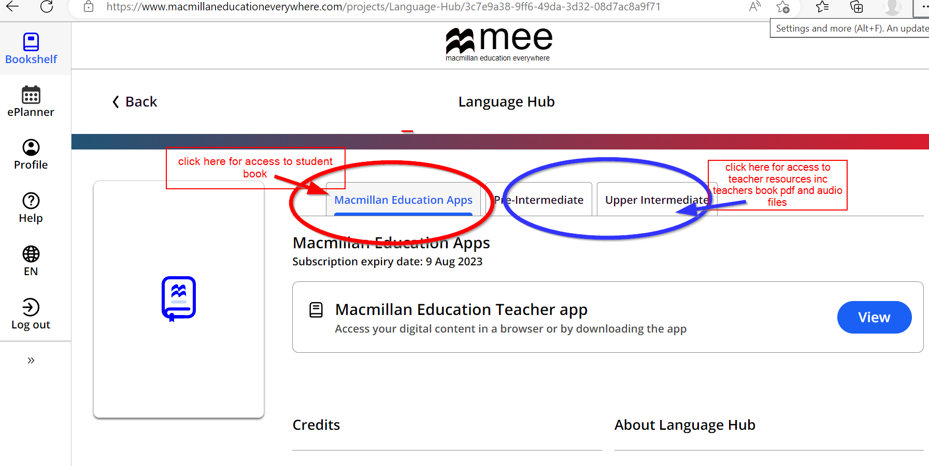
STUDENT BOOK OR TEACHER RESOURCES?

Slide 5
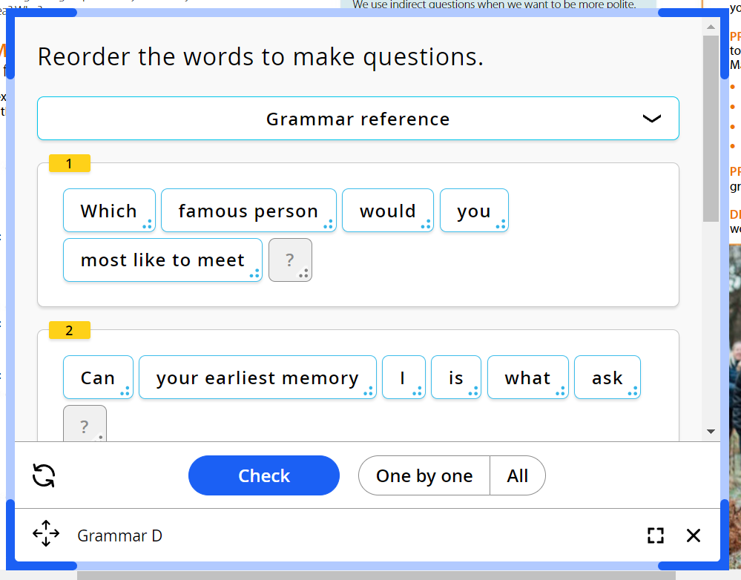
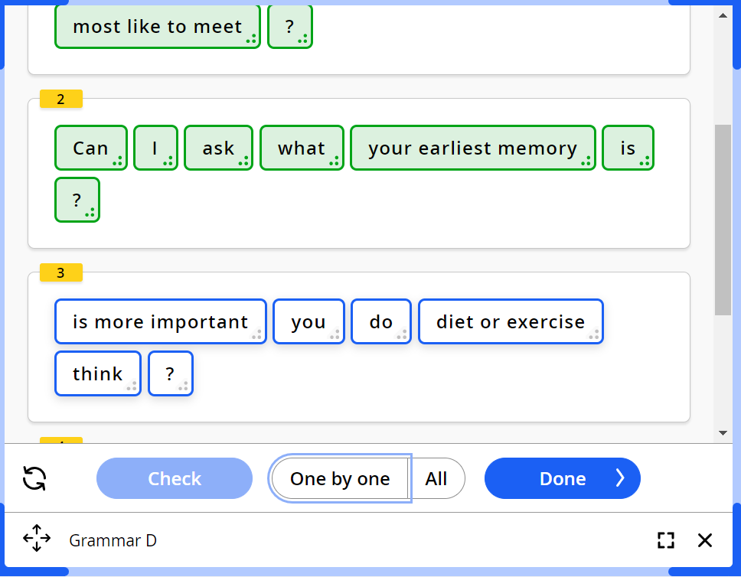
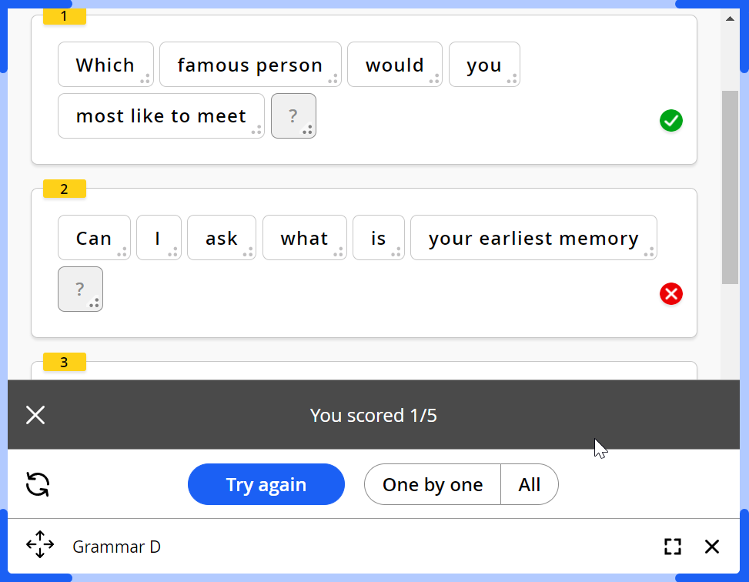
MEE DIGITAL FEATURES
Activities –
click on activity icon
complete activity
check answers

Slide 6
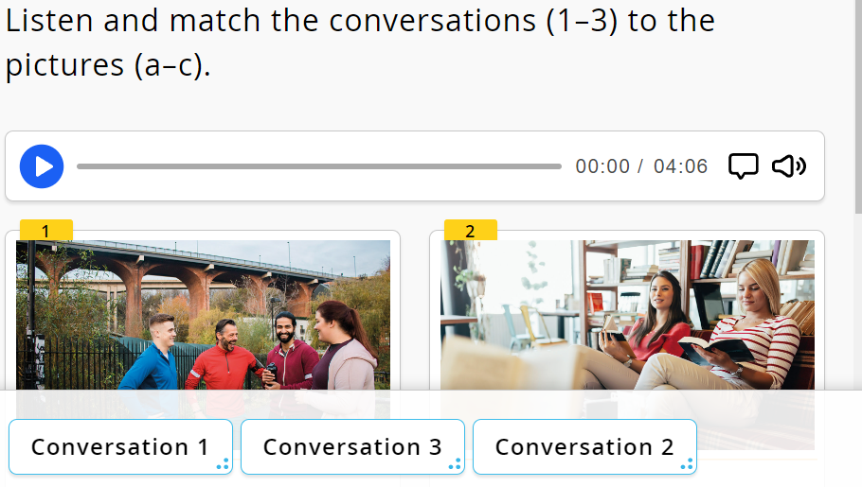
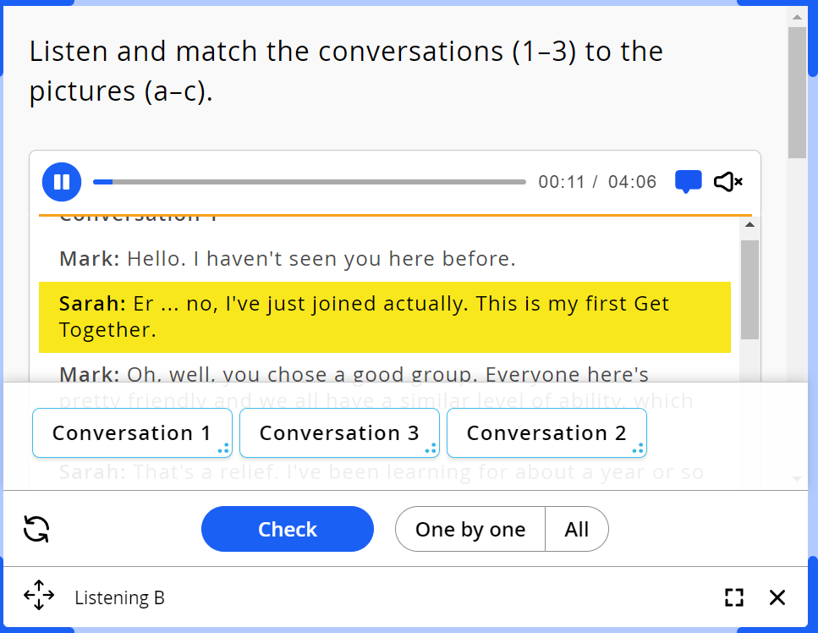
MEE DIGITAL FEATURES
Audio –
click on activity icon
click play on audio icon
click text icon for script

Slide 7
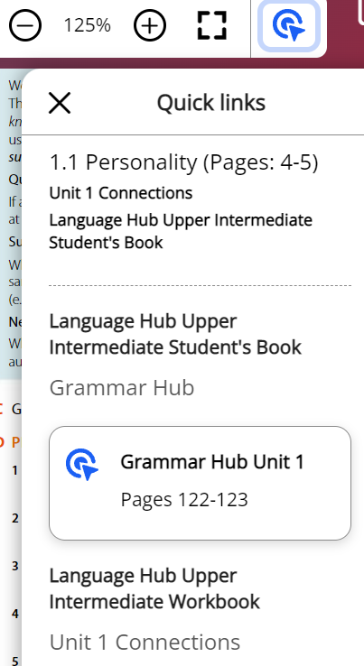
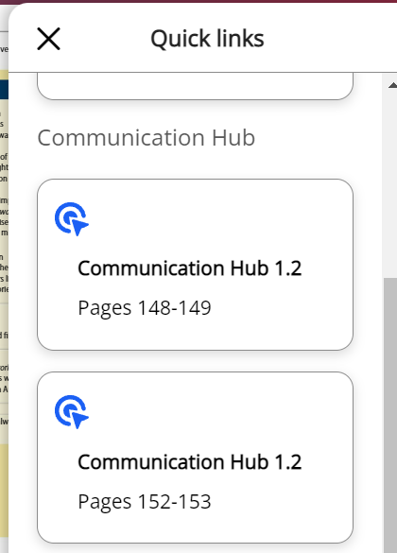
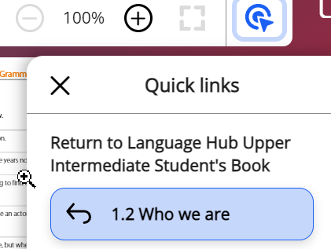
MEE DIGITAL FEATURES
Navigation – quick links tab
Click on ‘target’ icon
Select Grammar Hub / Workbook / other options
Click on ‘target’ icon again to return to original page

Slide 8
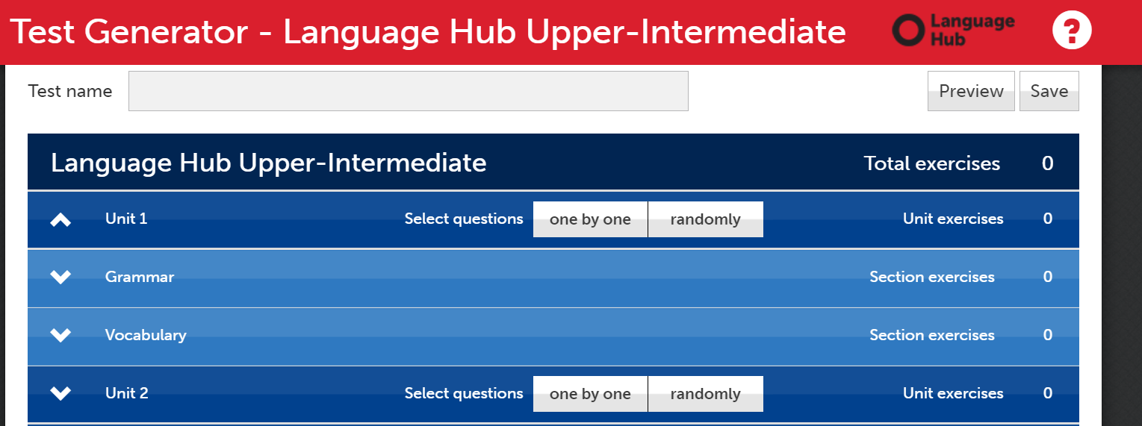
MEE DIGITAL FEATURES
Test Generator
Ready made unit / mid course
Customised – language
skills
PDF version to send

Slide 9
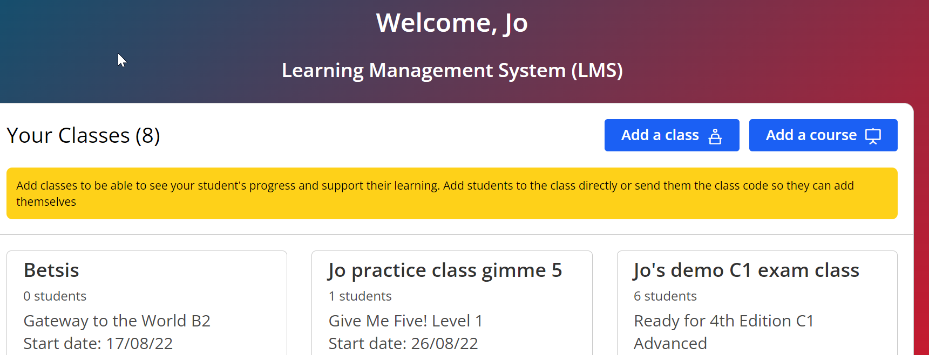
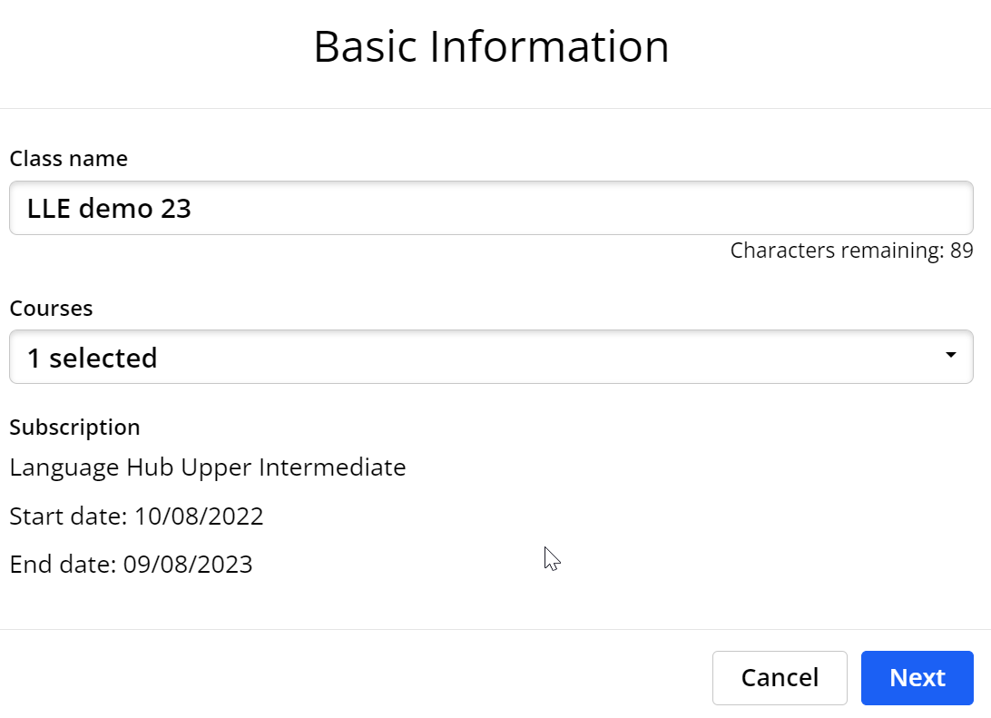
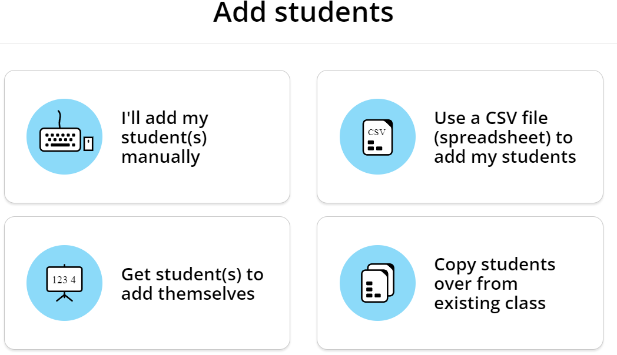
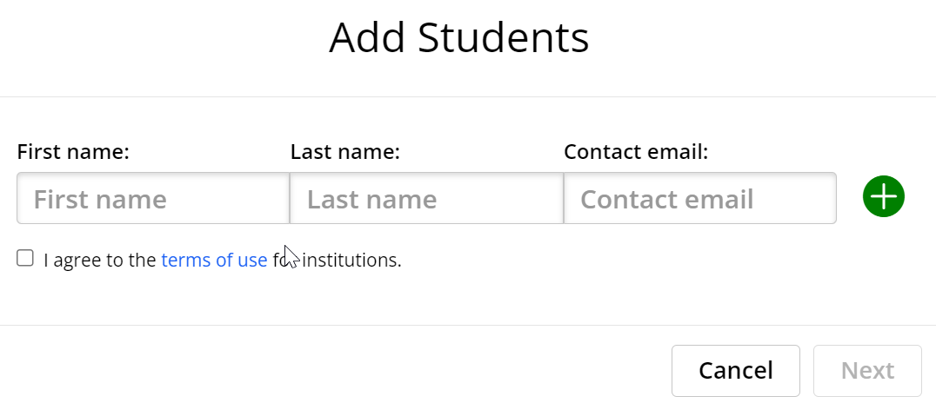
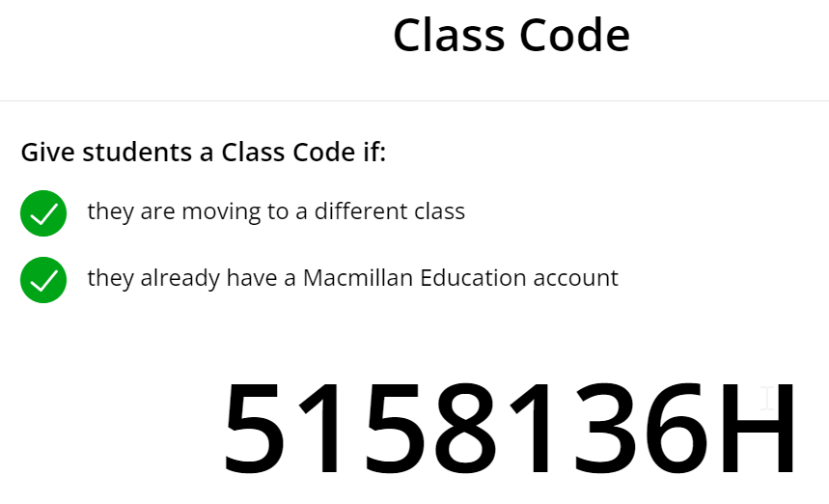
MEE DIGITAL FEATURES
Class management

Slide 10
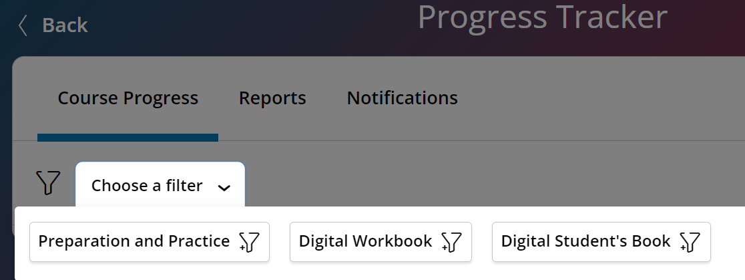
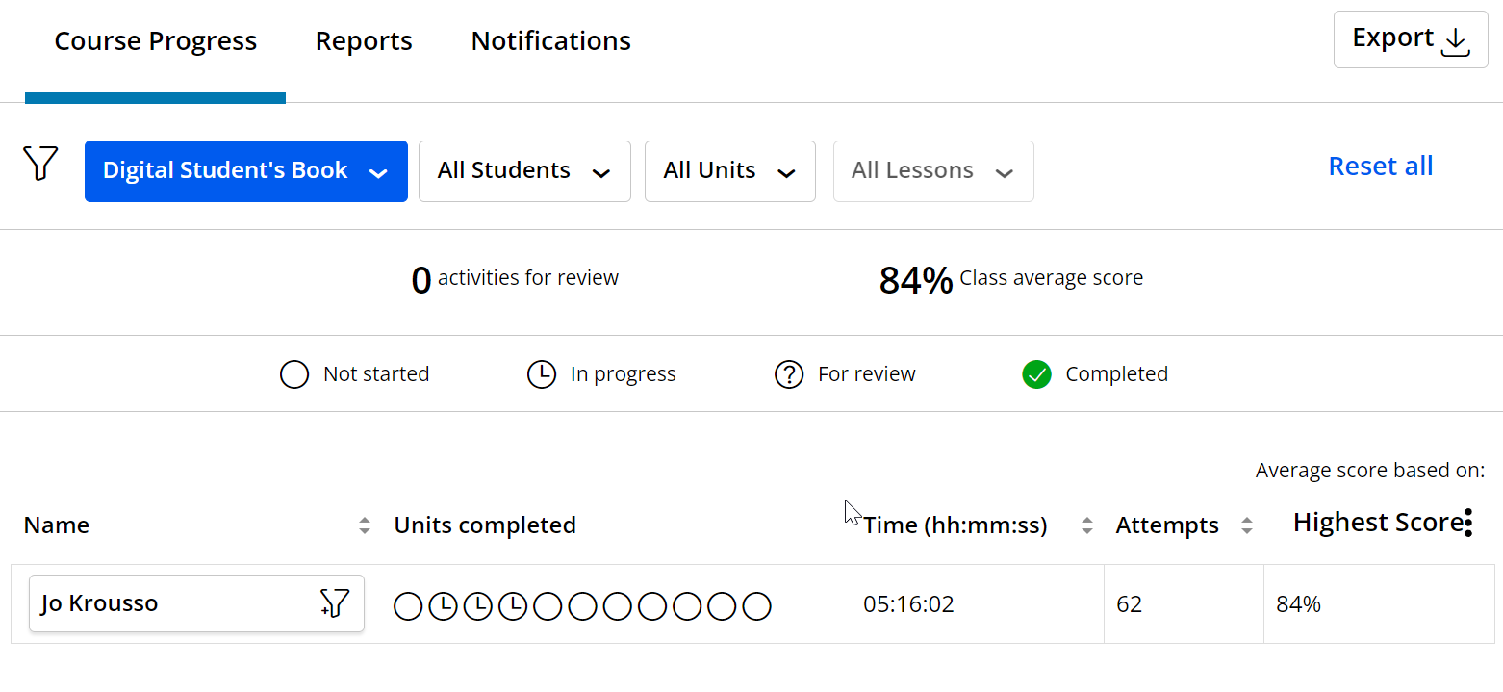
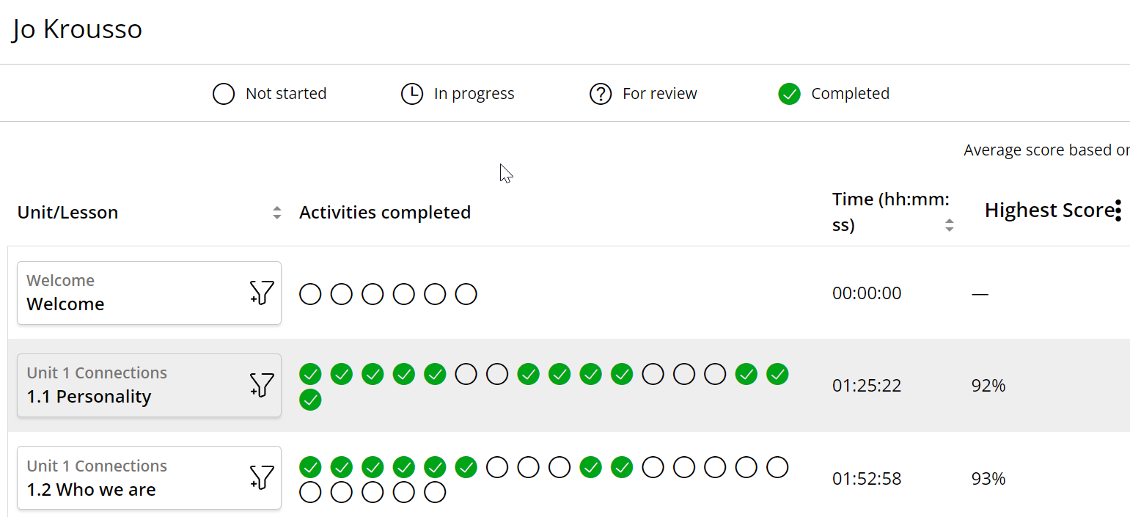
MEE DIGITAL FEATURES
Progress

Slide 11
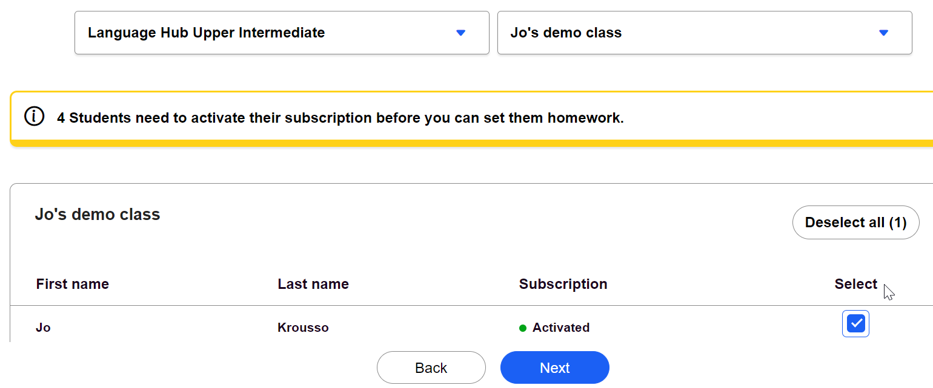
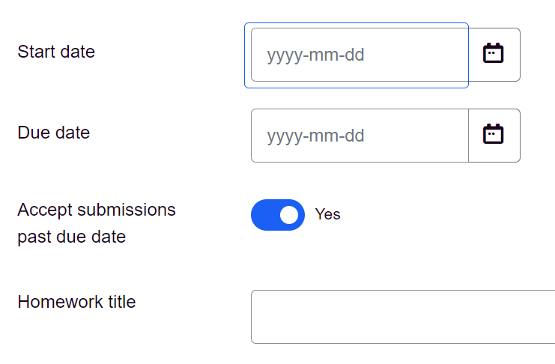
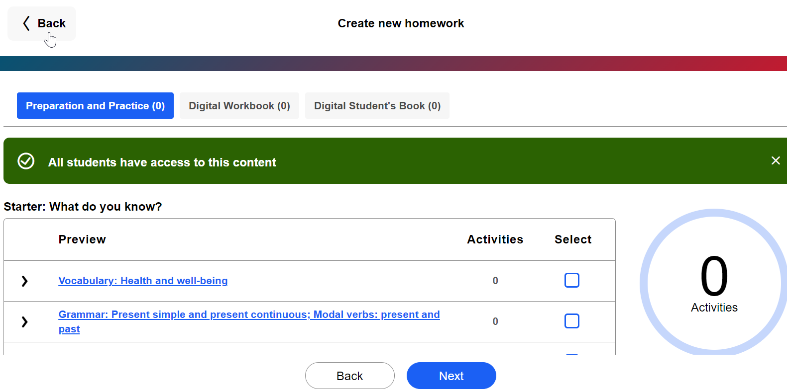
MEE DIGITAL FEATURES
Homework

Slide 12
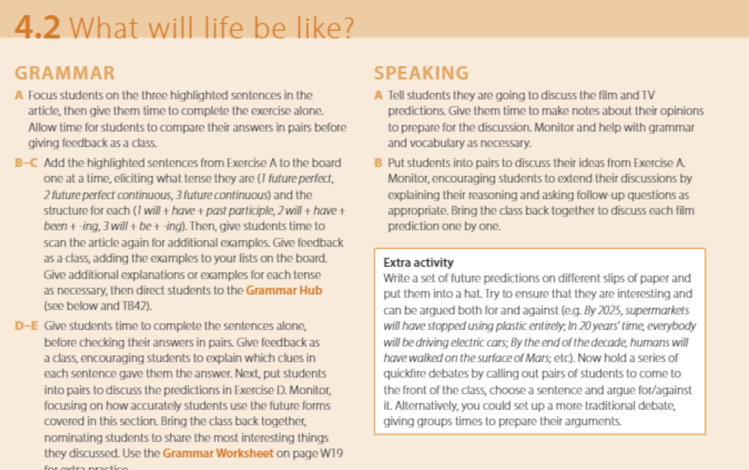
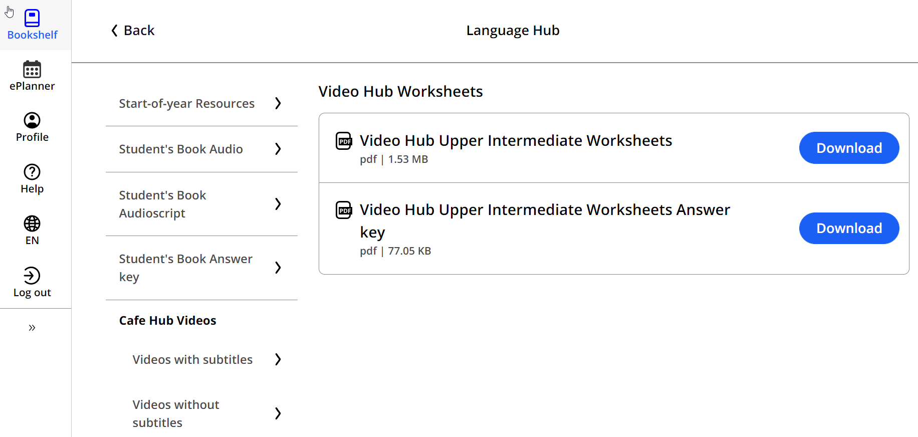
MEE DIGITAL FEATURES
Teachers book
Extra resources

Slide 13
THANK YOU!

